Slide 1
The Technology of SAP R/3 – ABAP/4
Rajesh Mishra

Slide 2
Programming Language ABAP/4
A dvanced
B usiness
A pplication
P rogramming
/
4
ABAP/4 is a programming language created by SAP for the interactive development of application programs.
ABAP/4 is a 4th generation programming language.

Slide 3
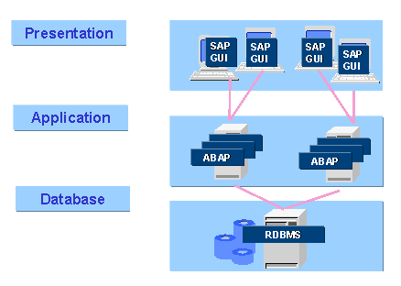
R/3 is Integrated
Common Database
Common Data Dictionary
Application Update flows to all related systems
  One point of data entry
  Consistent data
  Elimination of redundant data
Consistent User Interface

Slide 4
R/3 Architecture
R/3 Applications
BASIS
R/3 Middleware
Systems Software
Hardware

Slide 5
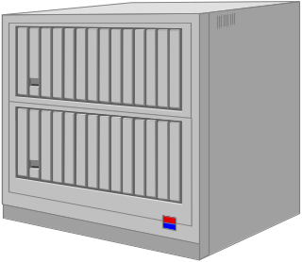


SAP Architecture
Internet
HR
FI
Database Server
Application Servers
Presentation Servers

Slide 6
System Platforms
UNIX BOXES
DEC ALPHA
INTEL
IBM AS 400
Hardware
UNIX:
Most Variants
Windows NT
OS400
Operating
Systems
ADABAS,
DB2 for AIX
Informix
ORACLE
MS SQL
Server
DB2/400
Databases
Win 3.1, Win 95, Win NT, OSF Motif,
Presentation Manager, MacIntosh
Win ‘95
OS/2
Dialog
SAPGUI
ABAP/4, C, C++
Languages

Slide 7
What is 3-Tiered?
3 Functional Areas
  Presentation
    workstations
  Application Logic
    small boxes
  Data Management
    large box

Slide 8
R/3 Middleware: Interfaces to Systems Software
R/3
DB
Inter-
face
Pres
Inter-
face
Database
Presentation
OS Interface
Client server
Uses underlying relational databases
  ORACLE
  SQL Server
  Ingress
  Sybase
Its Graphical User Interface
  SAP GUI
Operating
System

Slide 9
BASIS Components
ABAP Workbench
R/3 Application Components
(Logistics, Accounting, HR etc.)
BASIS Layer
Database Layer
Operating System / Hardware

Slide 10
Application Layer
Dispatcher
R/3 Work Processes
  D Dialog
  V Update
  E Enqueue
  B Batch (Background)
  M Message
  G Gateway
  S Spool

Slide 11
Database Layer
Consists of a relational database (Oracle, Informix, DB2 etc.)
Every work process makes a connect to the database
Communication between Application Layer and Database Layer is on Open SQL
Table Types in the SAP
  Transparent Tables (1:1) relation with the RDBMS Data Dictionary
  Table Pools
  Table Clusters

Slide 12
Summary
SAP R/3 is
  Client Server
    3 Tier
      Presentation
      Application
      Database
  Relatively hardware and database independent
SAP R/3 offers
  comprehensive suite of integrated applications meeting the needs of most business
  best practice process design
  ability to configure to
    industry sector
    unique business requirements

Slide 13
What is ABAP ?
ABAP stands for Advanced Business Application Programming and is the proprietary language / environment of SAP
SAP’s standard business content is developed using the ABAP workbench
Advanced Business Application Programming - 4th generation Language.
ABAP/4 is the backbone of SAP R/3.
All the R/3 applications and parts of Basis system were developed in ABAP/4.

Slide 14
ABAP Cycle
ABAP/4 Dictionary SE11
Transport Organizer
SE10
ABAP/4 Editor
SE38
Transactions
SE93
ABAP/4
Function Library
SE37
Menu Painter
SE41
Object Browser
SE80
Screen Painter
SE51

Slide 15
Data Dictionary
  TABLES
  DOMAINS
  DATA ELEMENTS
  VIEWS
  DATA TYPES
  STRUCTURES
  SEARCH HELP
  LOCK OBJECTS

Slide 16
Types of Programs
Report programs
  Basic List
  Interactive List
  ALV
SAPScripts Print Programs
Smartforms Print Programs
Dialog Programming
User Exits
BDC Programs

Slide 17
Testing & Analysis Tools
SQL Trace (ST05)
Run Time Analysis(SE30)
Extended Program Check(SE38 Built-in)
CATT

Slide 18
DATA TYPES AND THEIR ATTRIBUTES
Data Type
Meaning
Initial value
Std length
Allowed
length
P
Packed Number
0
8
1-16
I
Integer
0
4
-
F
Floating point no.
0.000 . . .
8
-
N
Numeric text
00 . . . 0
1
1-max
C
Text
Space
1
1-max
D
Date YYYYMMDD
00000000
8
8
T
Time HHMMSS
000000
6
6
X
Hexadecimal
X ‘00’
1
1-max

Slide 19
ABAP Key Words
Declaratives (DATA,.)
Events(AT…)
Control (IF,...)
Operational (WRITE,)

Slide 20
Events
Basic List
      INITIALIZATION.
      AT SELECTION-SCREEN ON input.
      AT SELECTION-SCREEN.
      START-OF-SELECTION.
      TOP-OF-PAGE.
      END-OF-PAGE.
      END-OF-SELECTION.
Interactive List
      TOP-OF-PAGE DURING LINE-SELECTION.
      AT LINE-SELECTION.
      AT USER-COMMAND.
      AT PF-KEY
Dialog Programming
      PBO (Process before output)
      PAI (Process after input)
      POV (Process on value request)
      POH (Process on help request)

Slide 21
Additional Features
HIDE TECHNIQUE
- HOTSPOT
- GET CURSOR FIELD < FIELD NAME>
MENU POINTER
- SET PF-STATUS < LITERAL>
FIELD SYMBOLS.

Slide 22
Control Break Statements
AT FIRST …. ENDAT
AT NEW …. ENDAT
AT END …. ENDAT
AT LAST …. ENDAT

Slide 23
SUBROUTINES
Syntax:
PERFORM <ROUTINE NAME> USING/CHANGING <PARAMETER>.
FORM <ROUTINE NAME> USING/CHANGING <PARAMETER>
…
ENDFORM.
Methods:
CALL BY REFERENCE
CALL BY VALUE
CALL BY VALUE AND RETURN

Slide 24
DIALOG PROGRAMMING
Validation Types:
Automatic field checks
Field level validations
Module level validations
Screen Types:
Normal screen
Sub screen
Dialog screen
Controls:
Table control
Step loops
Tab strips
Example: From ABAPDOCU
SAPMDEMO_TRANSACTION
Screens-> complex->Table control
Screens-> complex->Step loops
Screens-> complex->Tab strips

Slide 25
ABAP PROGRAMMING

Slide 26
ABAP/4: General Programming
Online programming
Batch-Input
Layout
Module
pool
Non-SAP
system
Checks
SAP
Flow logic
Screen
When using online programming techniques to write a program in ABAP/4, you create a module pool. These modules are called by the screen processor during screen processing.
Batch input is used for automatic, protected data transfer to the SAP System.
ABAP/4
Computer
1
Computer
2
Inter-system communication
Reports/Interactive Reports
Notes:
ABAP/4 contains statements for the programming of communications programs conforming to CPI-C standards.

Slide 27
ABAP Workbench

Slide 28
ABAP Workbench Purpose & Function
SAP’s Integrated Graphical Programming Development Environment:
  Used to create/change ABAP application programs
  Each ABAP application program is either a report or a transaction:
    Reports are applications that retrieve and display information from database with little or no user interaction
    Transactions accepts inputs/data from users and then perform one or more relevant actions, usually involving updating databases
The Workbench can be used to
  write ABAP code
  design dialogs/screens with a graphical editor
  create menus with a menu editor
  debug an application
  test an application for efficiency
  control access to objects under development
  create new or access predefined database information
Notes:
The ABAP Workbench is the SAP’s integrated development environment for the creation and management of ABAP reports, dialog programs, and associated objects (such as menus and screens).
In general ABAP programs are used for creating reports that extract and display data from the database or for creating dialog programs that allow the user to change data in the database in a controlled manner.
Another common application for ABAP programs is for data conversion. Typically this is a once only operation when R/3 is installed and existing data must be migrated from the current system to the R/3 tables.

Slide 29
ABAP Workbench Purpose & Function
Comprises the following tools
  The Object Navigator
  the ABAP Language
    the Screen and Menu Painters
  the Repository Information System
  the Data Modeler
  various test and analysis tools
  the ABAP Query
  the Workbench Organizer

Slide 30
ABAP Workbench Purpose & Function
Transport System
This models the Development Workbench and shows how the tools interact with the R/3 Repository and emphasise the integrated nature of the Workbench tools.
ABAP
Editor
Reporting
Screen
Painter
ABAP
Dictionary
R/3
Repository
Function
Modules
ABAP Organizer
Data
Modeler
Menu
Painter
ABAP
Processor
Debugging Trace Test Tuning

Slide 31
ABAP Workbench Purpose & Function
All R/3 screens have a similar ‘look and feel’
screens consist of
  screen titlebar
  menu bar
  standard toolbar
  application toolbar
  screen body
  message line
An important aspect of R/3 is that wherever you are in the system all screens have a consistent ‘look and feel’.
Screens have a consistent layout and similar modes of operation. The important, common features of the R/3 screens are illustrated in the next slide.
Something to keep in mind when you are developing your own ABAP applications is that your customer created screens are to be used in conjunction with the standard R/3 screens. Hence your screens should as far as possible comply with the SAP Style Guidelines for screen & report layout.

Slide 32
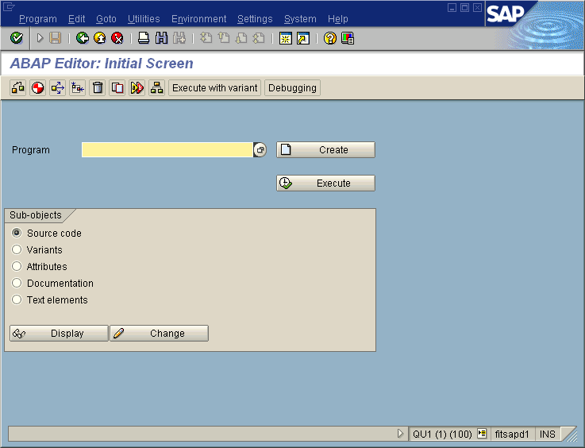
Menubar
Standard toolbar
Screen title-bar
Application toolbar
The Screen Titlebar displays the name of the screen. It is possible to program the contents of the screen titlebar to provide your own screen titles.
The Menubar provides a series of pull down menus. Different screens will have different menubar contents. However, all screens, (even the ones you create), contain the System and Help menus.
The Standard Toolbar is again common to all screens. Not all icons are active in all screens. (If they are not active they will appear ‘greyed out’.)
Standard toolbar includes from left
the Enter icon (green check mark)
the command entry box
the Save icon
the Back icon (also called Green Arrow Back)
the Exit icon
the Cancel icon
the Print icon
the Find and Find Next icons
4 navigation icons -Page up & down, top & bottom of page
the Help icon
Message line
Client
Server

Slide 33
The Object Navigator (The Repository Browser)
central tool for organizing and managing your personal development objects
used to navigate through development object lists
  where development objects are the components used to construct an application
automatically calls other workbench tools
  if you create a new data definition the browser calls the Data Dictionary, and then returns to the browser after the definition is created

Slide 34
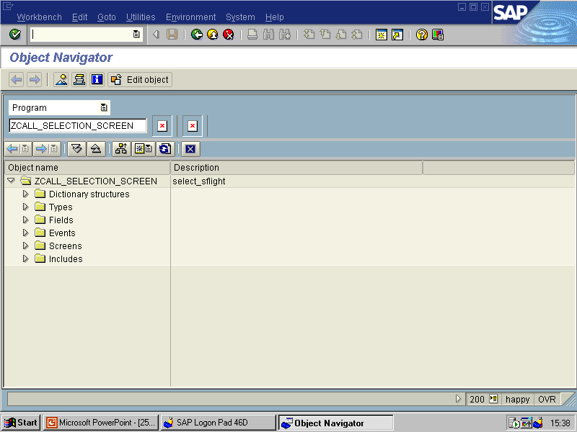
The Repository Browser has two basic interfaces. The one illustrated above is called the ‘Initial’ screen. (Note that it is not necessarily the default screen displayed when the Repository Browser tool is selected.)
Object selection is made by clicking the radio button next to the object type that you wish to select and then filling in the name of the object in the data entry box beside.
In general it is possible to provide a name involving wildcards, (such as ZAB*). The selector (down arrow) at right of the data entry box will provide a pull-down list of objects of the selected type that match the entered string.

Slide 35
Reporting
Uses ABAP Open SQL to extract data from the R/3 database
  Open SQL is a subset of ANSI SQL
Report consists of a [selection screen] and a list screen
  Selection screen allows the user to enter selection criteria
  List screen displays the report data
Reports extract and display data from the R/3 database.
In general Open SQL is used to extract the data. Open SQL is proprietary version of SQL developed by SAP.
Note that it is possible to extract data by methods other than using Open SQL (for example by embedding native SQL commands in your ABAP program).
In general, a report consists of an optional selection screen which allows the user to tailor/limit the data retrieved, and a lists screen where the selected data is displayed.

Slide 36
Reporting
This slide shows the general structure of an ABAP report and the interaction between the displayed data and the stored data.
The selection screen is used to filter rows to be returned from the data base. (ie, to fill in the where clause in an SQL select statement/s.)
Once the user has filled in the selection screen the appropriate rows are retrieved from the database and displayed on the list screen.
Selection
Screen
List
Screen
ABAP Open SQL
R/3 Database

Slide 37

Thank You

